Slide 1

Dependency Injection:
Way of the Ninja
Michael C. Neel
michael.neel@gmail.com
http://www.vinull.com
http://code.google.com/p/vinull

Slide 2
Dependency Injection (DI) in computer programming refers to the process of supplying an external dependency to a software component. It is a specific form of inversion of control where the concern being inverted is the process of obtaining the needed dependency.
-- http://en.wikipedia.org/wiki/Dependency_injection

Slide 3


Dependency Injection

Slide 4
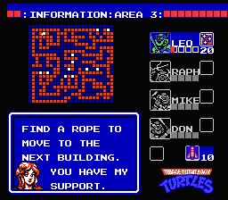
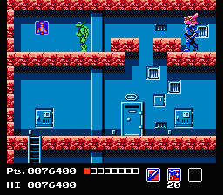
Dependency Injection

Slide 5
Why?

Slide 6

Testability
Notes:
http://flickr.com/photos/cristic/359572656/

Slide 7
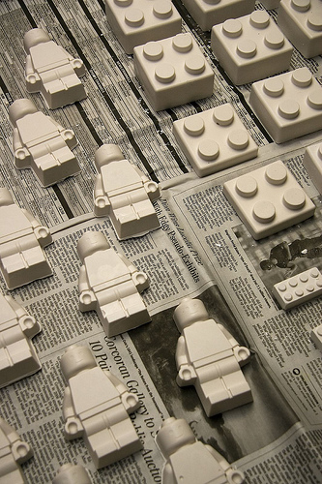
Loose Coupling
Notes:
http://flickr.com/photos/tracyleephoto/2925320390/

Slide 8

Highly Cohesive
Notes:
http://flickr.com/photos/margolove/1810357551/

Slide 9

Code Reuse
Notes:
http://flickr.com/photos/nickwheeleroz/2295584401/

Slide 10

Notes:
http://www.flickr.com/photos/christopherdale/258154895/

Slide 11

Notes:
http://starwrecked.com/Star-Trek-desktops-wallpapers-3.htm

Slide 12

DI in the UI
Notes:
http://flickr.com/photos/drurydrama/1942011908/

Slide 13
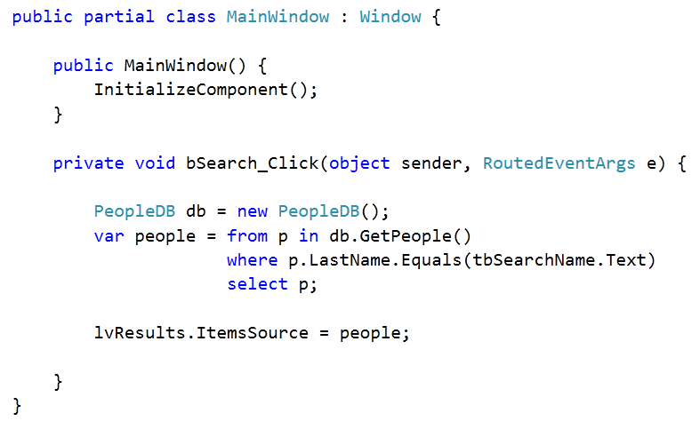

Slide 14
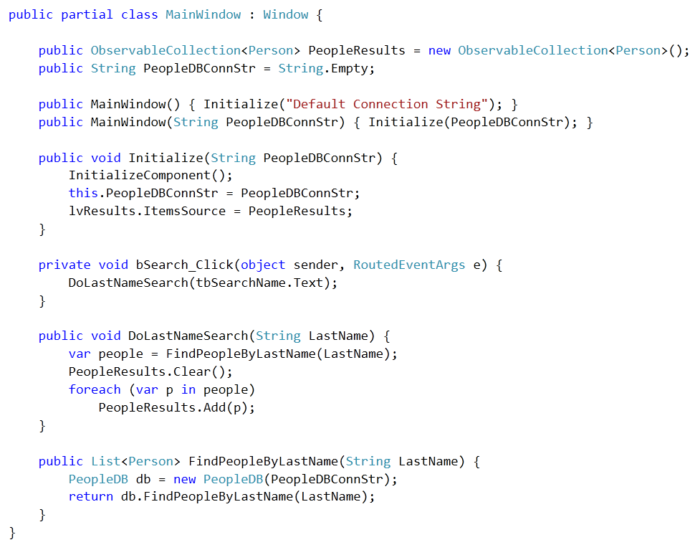

Slide 15

Do not pull data in the same method you act upon the data.
Notes:
http://www.flickr.com/photos/19779889@N00/2125586809/

Slide 16
Do not take action in events.
Notes:
http://www.flickr.com/photos/19779889@N00/2125586809/

Slide 17
Private only that which cannot be tested.
Notes:
http://www.flickr.com/photos/19779889@N00/2125586809/

Slide 18

DI in the
Constructor
Notes:
http://www.flickr.com/photos/saad/1968774/

Slide 19
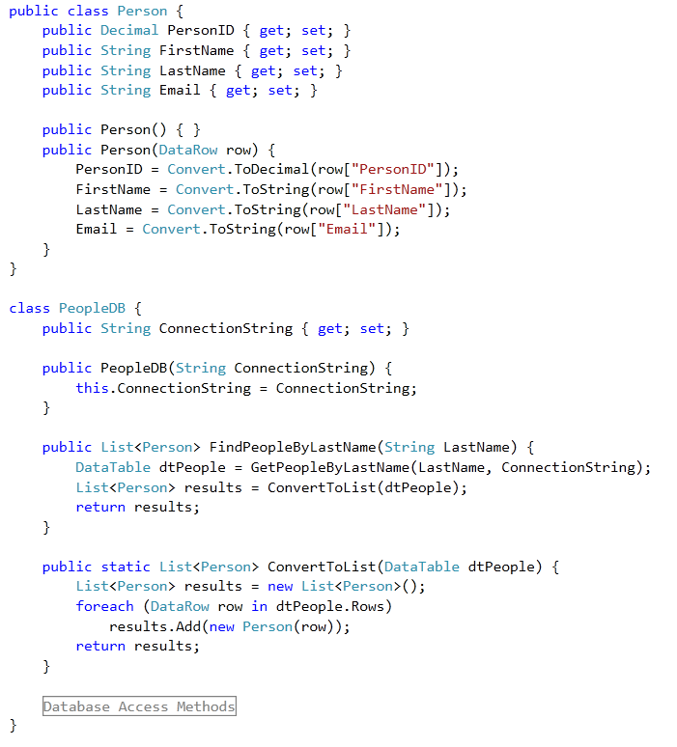

Slide 20
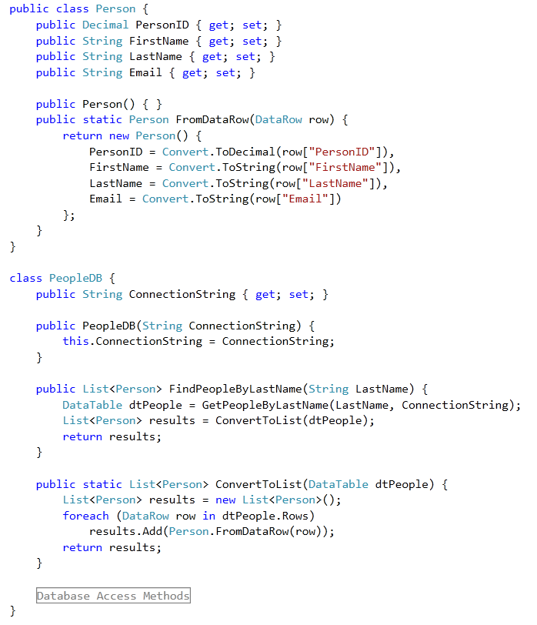

Slide 21
Use constructor overloads to data conversions.
Notes:
http://www.flickr.com/photos/19779889@N00/2125586809/

Slide 22
Force required dependencies in the constructor.
Notes:
http://www.flickr.com/photos/19779889@N00/2125586809/

Slide 23

DI using Interfaces
Notes:
http://www.flickr.com/photos/emagic/51069522/

Slide 24
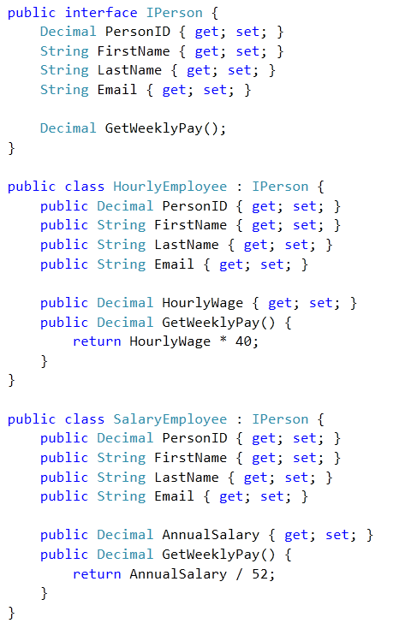

Slide 25
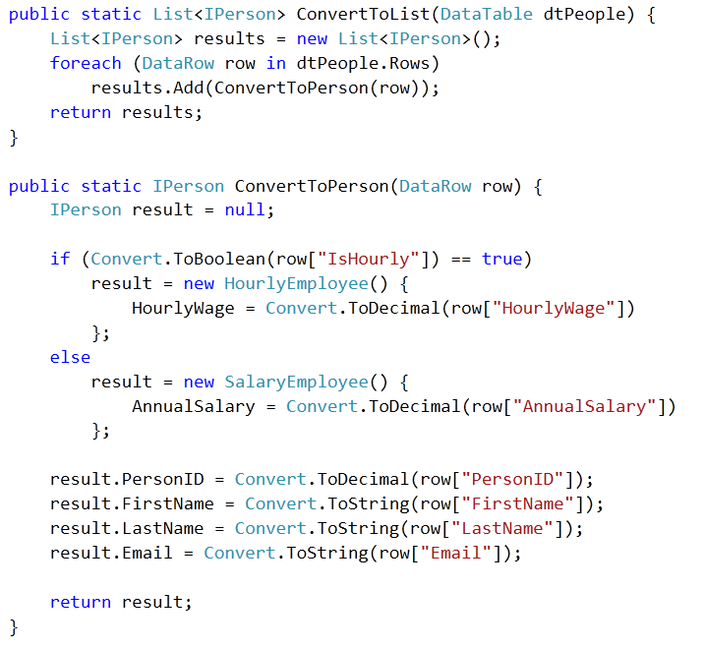

Slide 26
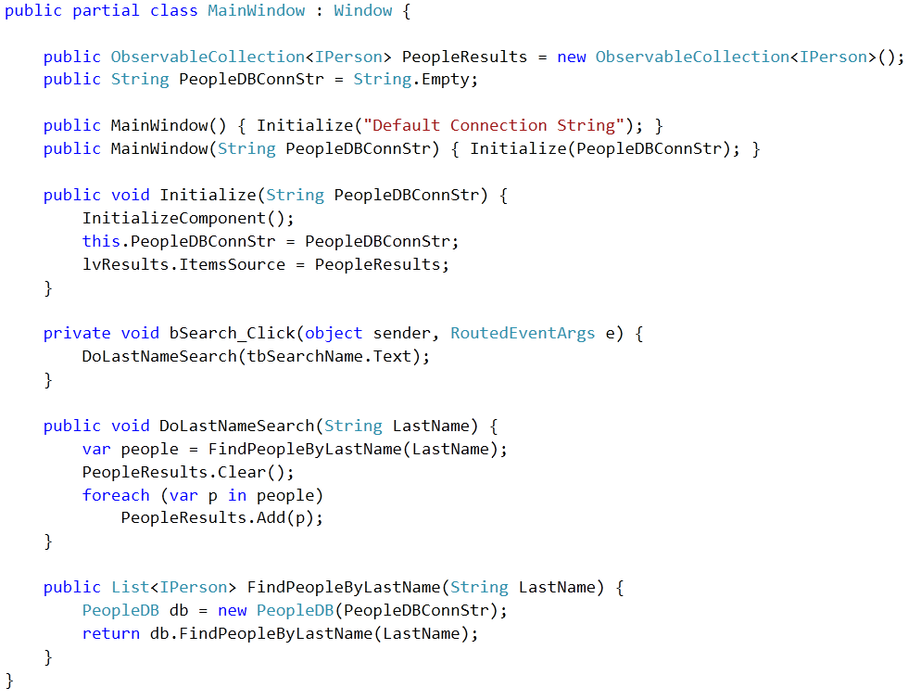

Slide 27
Interfaces add complexity and decrease flexibility.
Notes:
http://www.flickr.com/photos/19779889@N00/2125586809/

Slide 28
Use Interfaces when multiple developers work on a common code base.
Notes:
http://www.flickr.com/photos/19779889@N00/2125586809/

Slide 29
Use Interfaces when multiple data objects can share data methods.
Notes:
http://www.flickr.com/photos/19779889@N00/2125586809/

Slide 30

DI using Factories
Notes:
http://www.flickr.com/photos/davipt/164341428/

Slide 31
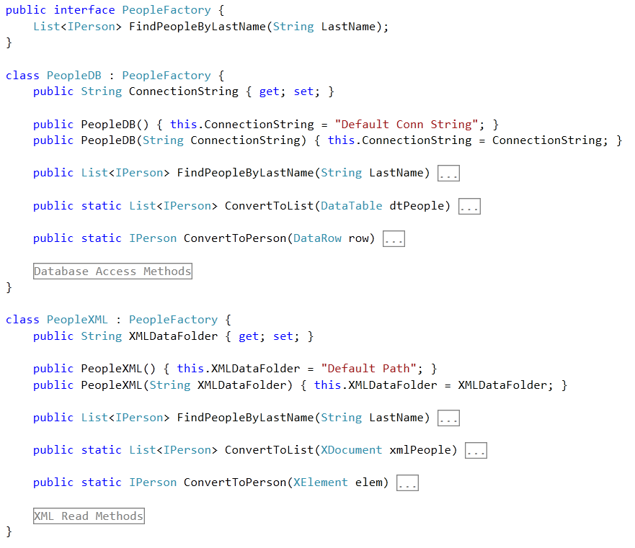

Slide 32
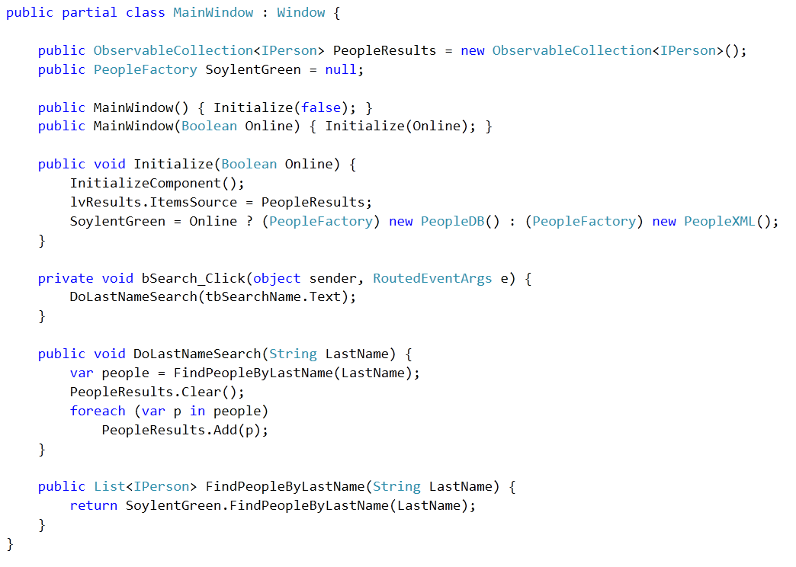

Slide 33
Factories are expensive, consider the need first.
Notes:
http://www.flickr.com/photos/19779889@N00/2125586809/

Slide 34
Factories only help when there are two or more.
Notes:
http://www.flickr.com/photos/19779889@N00/2125586809/

Slide 35
Consider a framework, do not roll your own.
Ninject
Castle Windsor
StructureMap
Unity
Notes:
http://www.flickr.com/photos/19779889@N00/2125586809/

Slide 36
DYHAQFM?
Michael C. Neel
michael.neel@gmail.com
http://www.vinull.com
http://code.google.com/p/vinull

